Slide 1
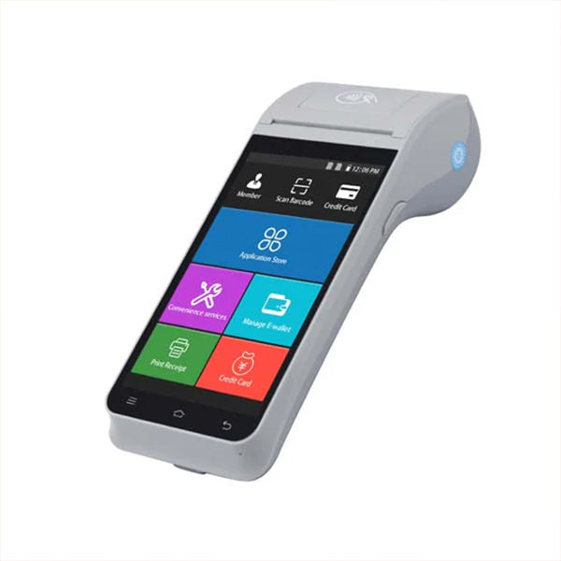

MandroidPOS
MandroidPOS
Android Point of Sale Solutions

Slide 2
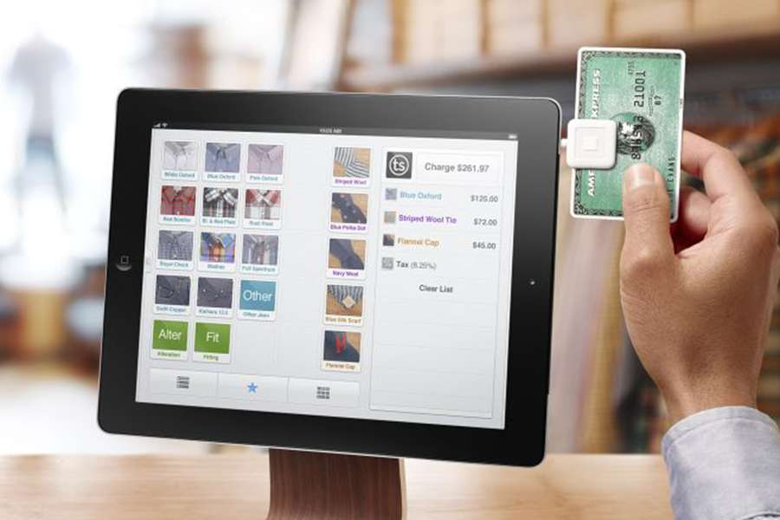




What is Android POS?
Android POS (Point of Sale) systems are modern, versatile solutions that transform Android devices into powerful retail management tools.
Versatile Platform
Leverages Android OS flexibility for various business needs
Payment Processing
Secure and efficient transaction handling
Inventory Management
Real-time stock tracking and management
Cost-Effective
Affordable alternative to traditional POS systems

Slide 3


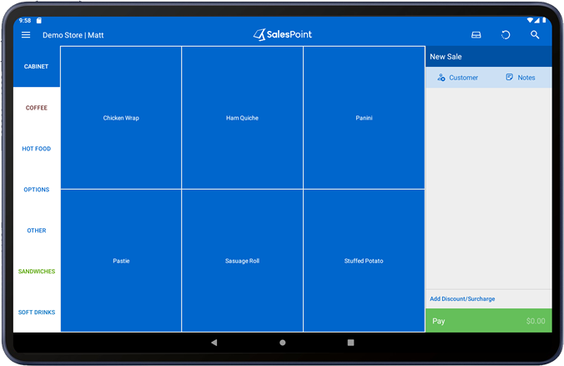



Key Features
Intuitive Touchscreen
Interface
Secure Payment Processing
User-friendly design for quick navigation
PCI compliant transactions with encryption
Real-time Inventory
Management
Customer Relationship
Management
Track stock levels across all locations
Build and maintain customer profiles
Sales Reporting & Analytics
Employee Management
Data-driven insights for business growth
Track performance and manage permissions

Slide 4



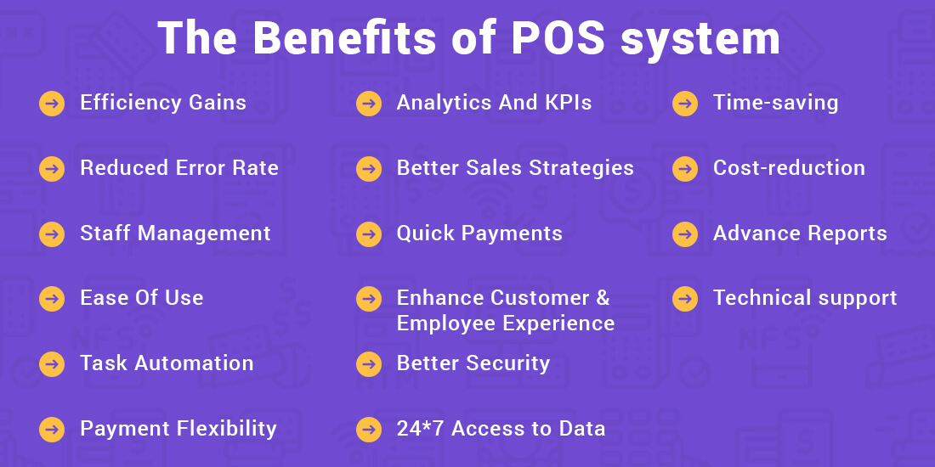



Business Benefits
Increased Efficiency
Reduced Costs
Streamline operations and serve customers faster
Lower hardware and maintenance expenses
Enhanced Customer
Experience
Improved Inventory
Accuracy
Faster checkout and personalized service
Real-time tracking and reduced stock errors
Data-Driven Decisions
Business Scalability
Grow your business without system limitations
Actionable insights from sales analytics
Mobility & Flexibility
Easy Integration
Serve customers anywhere in your store
Connect with existing business systems

Slide 5

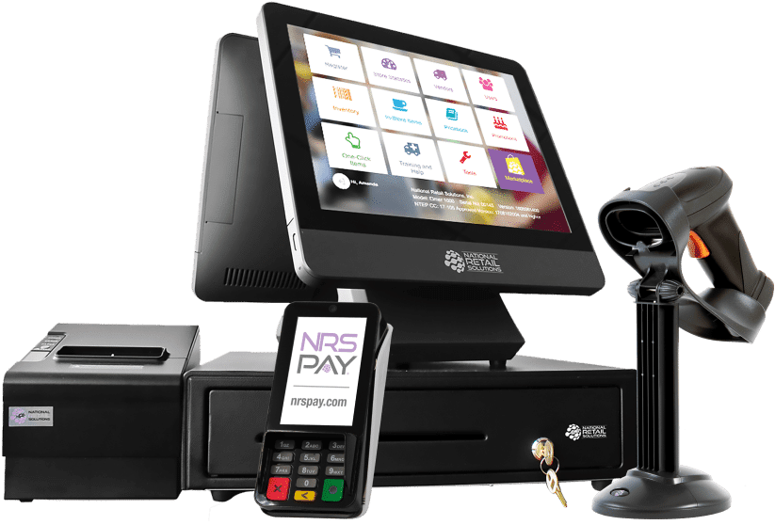






Hardware Components
Android Tablet/Terminal
Cash Drawer
Secure storage for cash transactions
Main interface device for running POS software
Receipt Printer
Barcode Scanner
Generates customer receipts and order tickets
Quick product lookup and inventory management
Card Reader
Customer Display
Secure payment processing for credit/debit cards
Shows transaction details to customers
Kitchen Printer
Scale
Sends orders directly to kitchen staff
Weighs items for accurate pricing in retail

Slide 6

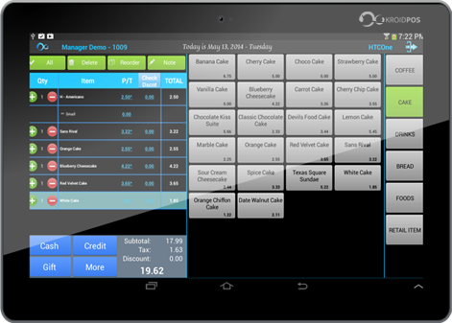




Software Capabilities
Sales Processing
Inventory Management
Fast checkout with multiple payment options
Real-time stock tracking and alerts
Customer Management
Employee Management
Customer profiles and purchase history
Role-based access and performance tracking
Reporting & Analytics
Loyalty Programs
Detailed sales reports and business insights
Customer rewards and retention tools
E-commerce Integration
Cloud Backup & Sync
Sync online and in-store inventory
Secure data storage across devices

Slide 7

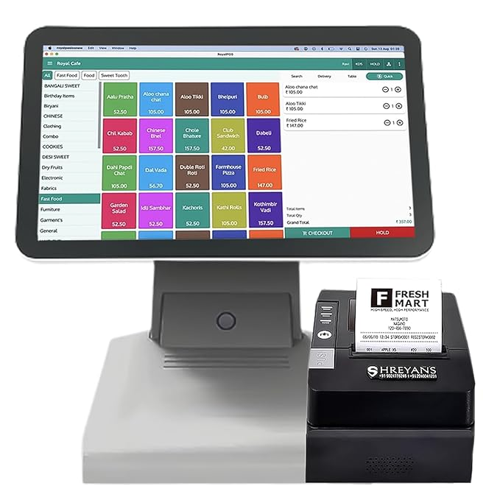






Industry Applications
Retail Stores
Restaurants & Cafes
Inventory tracking and customer checkout
Order management and table tracking
Bars & Nightclubs
Food Trucks & Kiosks
Tab management and age verification
Mobile payment processing and menu management
Beauty Salons & Spas
Service Businesses
Appointment scheduling and service tracking
Job tracking and client management
Pop-up Shops & Markets
E-commerce Businesses
Temporary retail with mobile setup
Online and in-person sales integration

Slide 8

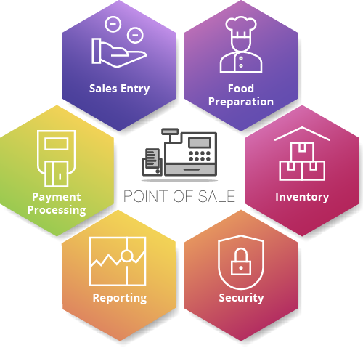


Integration Options
Payment Processors
Accounting Software
Credit cards, mobile payments, digital wallets
QuickBooks, Xero, Sage
E-commerce Platforms
Inventory Systems
Multi-location stock management
Shopify, WooCommerce, BigCommerce
CRM Solutions
Email Marketing
Customer data and relationship tracking
Mailchimp, Constant Contact integration
Loyalty Programs
Delivery Services
Rewards and customer retention tools
Uber Eats, DoorDash, Grubhub

Slide 9


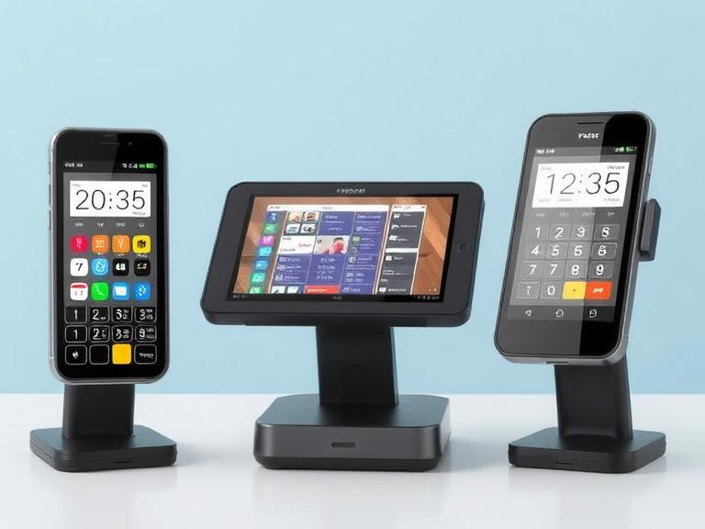





Get Started Today
bonrix@gmail.com
+9426045500
www.mandroidpos.com
Follow us on social media
Transform Your Business
Transform your business with our Android POS solutions. Contact us for a demo or more information.
Thank You!

